Slide 1
Software Foundations of Security and Privacy (15-316, spring 2016) Lecture 1: Introduction
Matt Fredrikson
Jean Yang
{mfredrik, jyang2}@andrew.cmu.edu

Slide 2
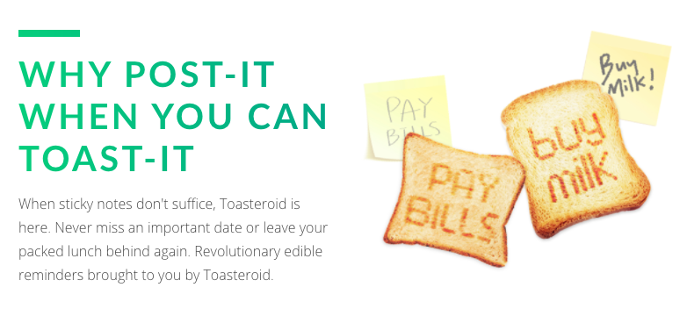
Case study: fancy toasters

Slide 3
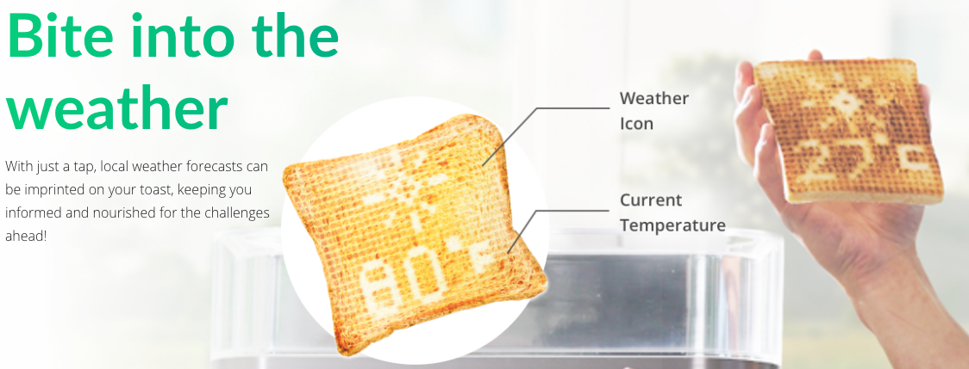
Case study: fancy toasters

Slide 4
Existential threats with toasters
Toast burns and you go hungry.
Toaster burns and your house burns down.
Toaster gets hacked, and you neglect to bring your umbrella.
Someone uses your toasting patterns to figure out when burgle you.
Someone figures out how to turn on your toaster remotely and your house burns down.
Software threats

Slide 5
Software requirements for toaster
Toaster should access the internet only to get the weather.
Toaster should get the “right” weather.
Toaster data should not be available to anyone but “you.”
Toaster should only be operated by “you.”
What does it mean to be “right?”
What does it mean to be “you?”

Slide 6
Authentication for smart toasters
Most IoT devices controlled by phone apps
How the toaster establishes trust:
Rely on home router to authenticate phone
Assume all devices authenticated on the network belong to “you”
Fine, don’t let any hackers onto your network
But, your router knows nothing about your apps
Do you trust every app you’ve ever downloaded?

Slide 7
Why we should worry
“Assuming it’s publicly accessible, the chance [of being hacked] is probably 100 percent… The IPv4 address space just isn’t that big. You can now run a scan across that entire space in hours, especially if you have a big botnet. The scans for vulnerability are continuous, and if anything, have accelerated over the last couple of years.”
- Matthew Prince, CEO of Cloudflare

Slide 8
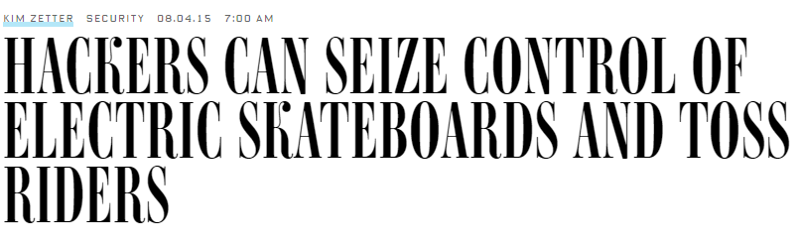
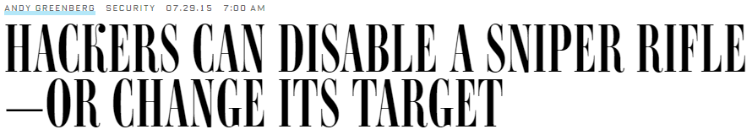
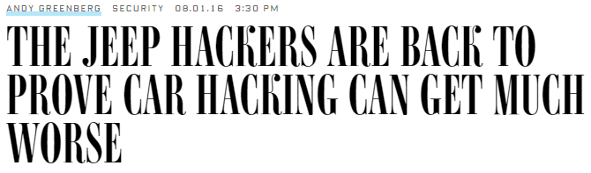
It’s not just toasters!

Slide 9
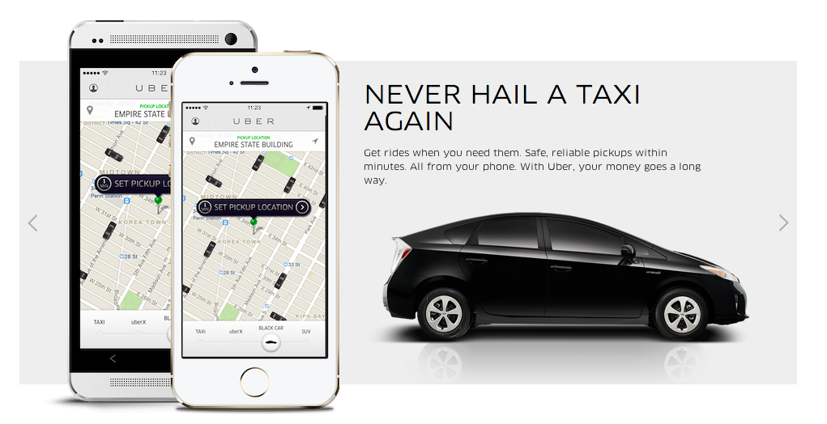
Case study: ride-sharing apps

Slide 10
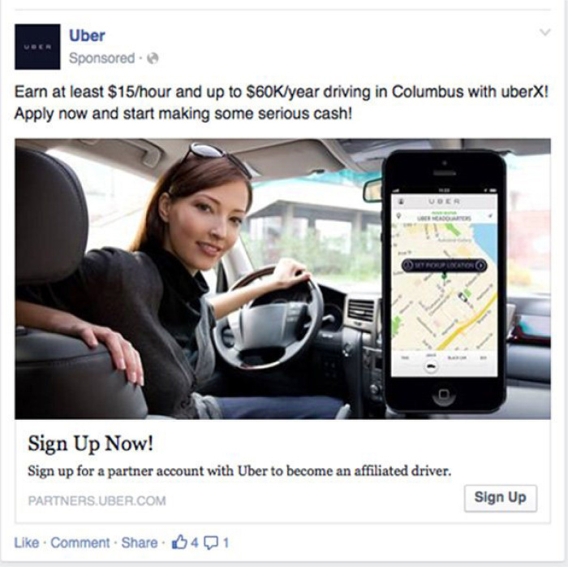
Case study: ride-sharing apps

Slide 11
Existential threats with Uber
Driver gets into accident.
Driver kidnaps us.
Driver steals our credit card number.
Our location gets hacked, and we get kidnapped that way.
People use our locations for stalking and blackmail.
Software threats

Slide 12
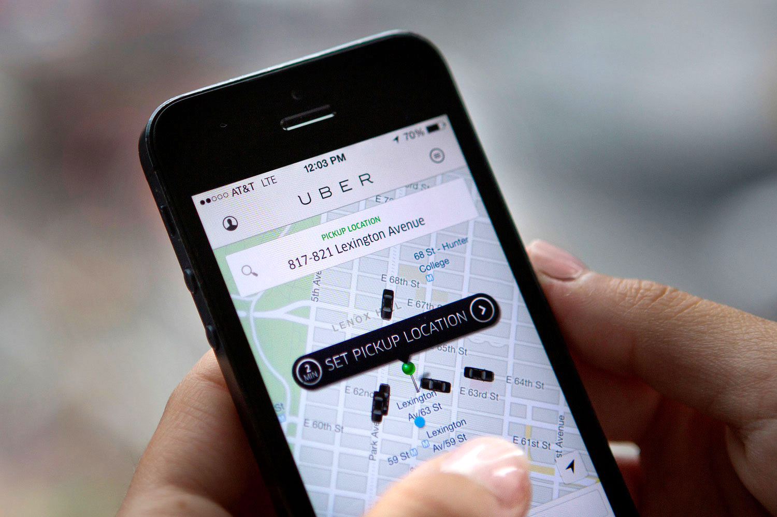
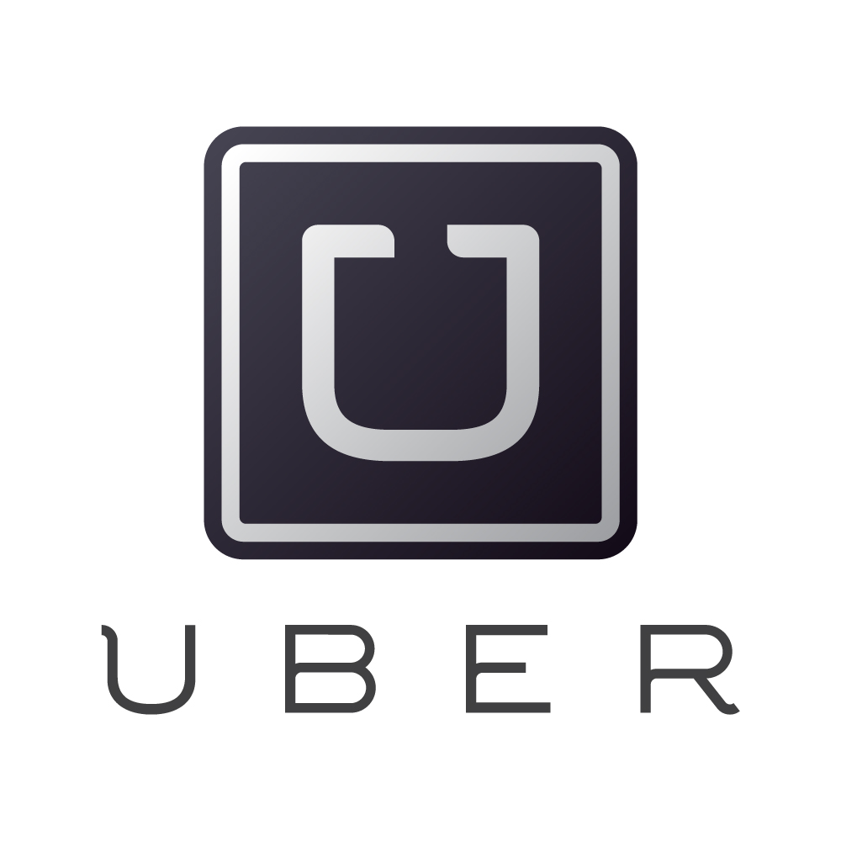
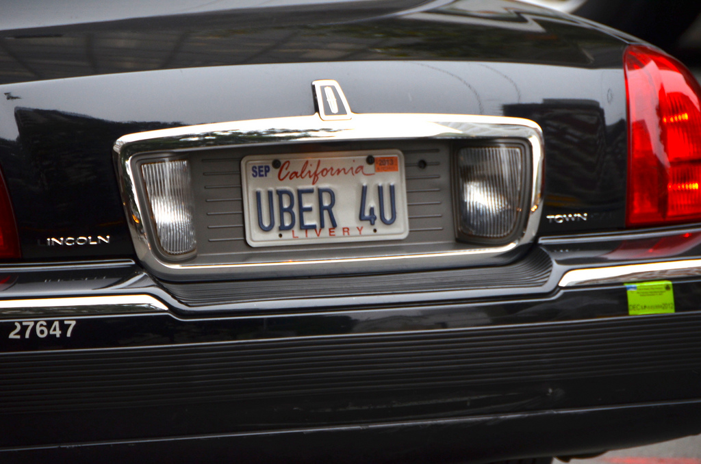
How we trust Uber with all data
Credit card number
Location
Credit card number
Location
Phone number
Past ride information
Phone number
Past ride information
User
Driver
Notes:
[Talk about how Uber works]

Slide 13
Policies Uber needs to get right
Only Uber sees credit card numbers.
Drivers can see rider locations for duration of ride, but not more.
Riders can see driver locations for duration of ride, but not more.
Each user can see their own ride history.
Encryption is not enough!

Slide 14
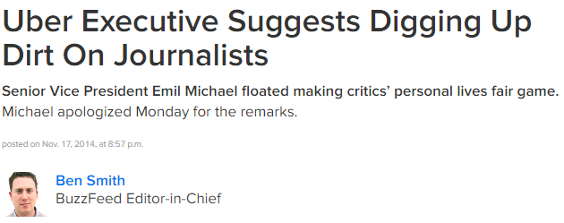
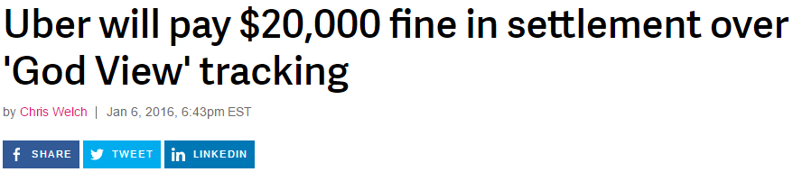
But we can’t even trust Uber!
Notes:
“Then he returned to the opposition research plan. Uber’s dirt-diggers, Michael said, could expose Lacy. They could, in particular, prove a particular and very specific claim about her personal life.”
Uber and New York Attorney General Eric Schneiderman have reached a settlement over the company's "God View" tool, which allowed employees to access and track the location of Uber riders and customers without obtaining permission. In 2014, one high-up Uber executive was found to have monitored the rider logs and location of a BuzzFeed News reporter without her knowledge. Subsequent reports on the incident led Uber to investigate and eventually discipline the employee, but also got the attention of lawmakers. As a result of New York's investigation, Uber will pay a $20,000 fine, which amounts to less than a slap on the wrist for a company with Uber's soaring valuation.

Slide 15
Lessons for the paranoid
Don’t trust anybody.
Never, ever use anything connected to the internet.
Just to be safe, unplug all devices when you are not home.
Walk everywhere.
This course can’t help you. Goodbye!

Slide 16
What Is Software Security?

Slide 17
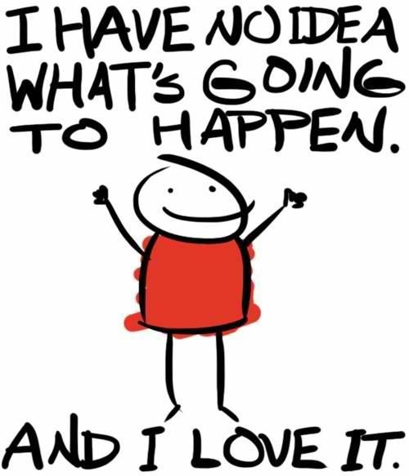
What were you expecting?
Notes:
[discussion with students]

Slide 18


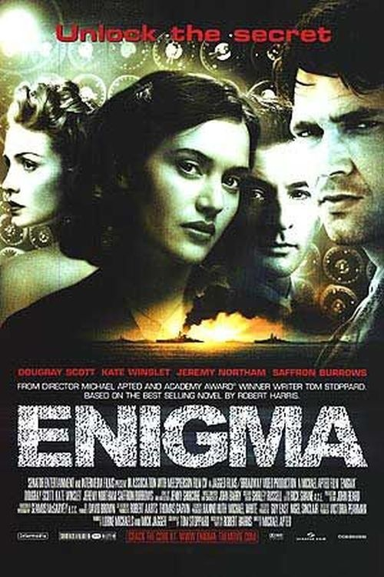
This is not a course about encryption

Slide 19
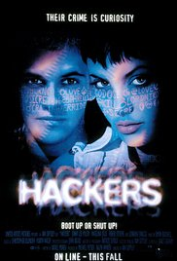
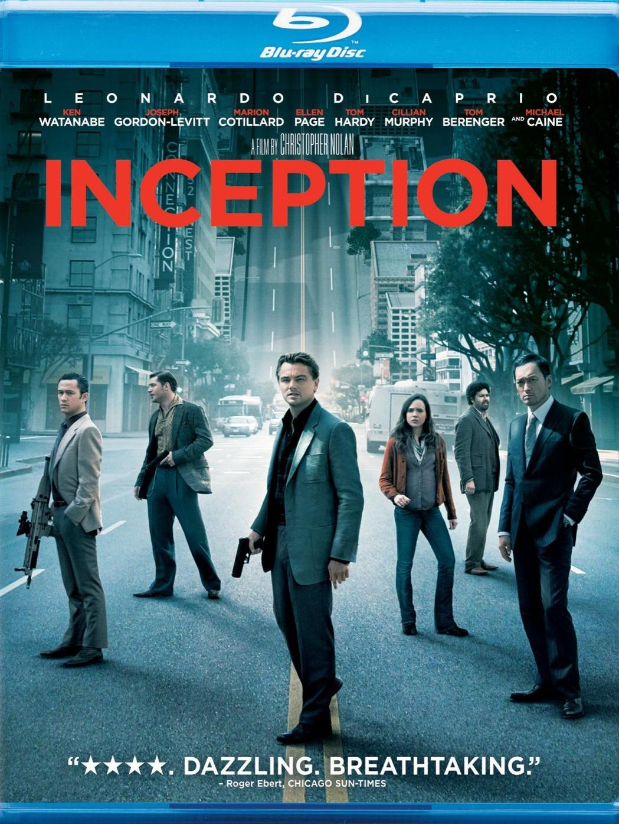

…Not a course about hacking

Slide 20
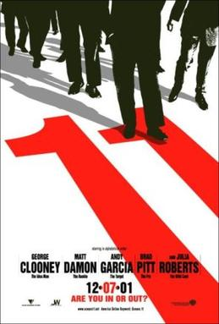
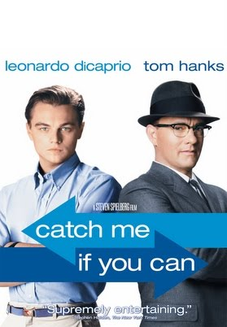
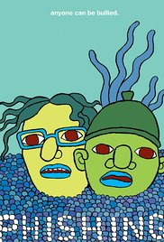
…Not a course about avoiding cons

Slide 21
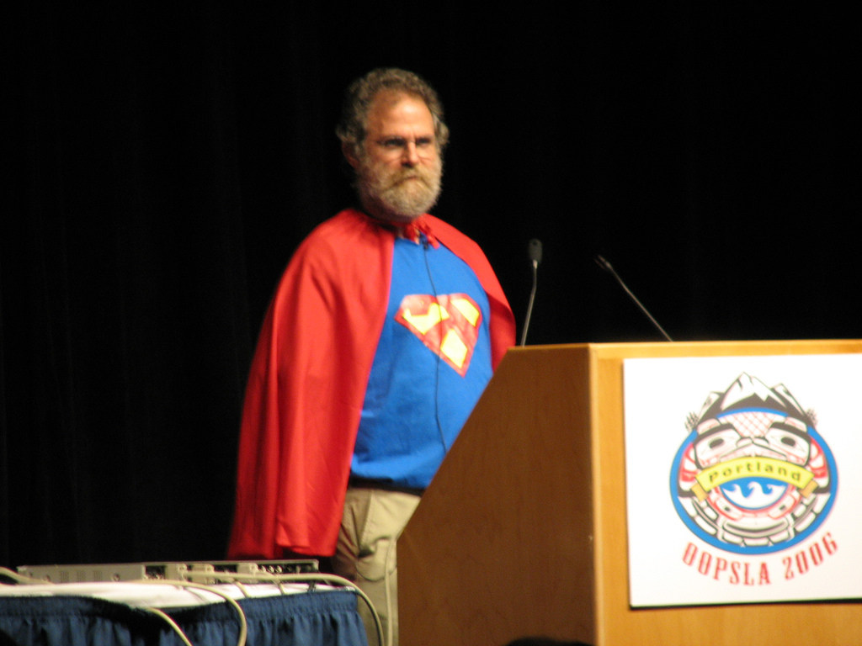
This is a course about how programming languages will save us

Slide 22
What we want need
Way of specifying a desired behavior for software.
Way of specifying who’s allowed to use software/view data, and how.
Way of ensuring software meets these specifications, even if we cannot trust the software creators or users.

Slide 23
What PL and formal methods give us
Ways of formally stating specifications about program behavior.
Ways of formally stating specifications about security and privacy.
Ways of verifying and testing programs with respect to specification.
Mechanisms for auditing third-party programs with sound guarantees.

Slide 24
What being formal gives us
We’re after formal security guarantees
A formal guarantee is:
Precise and unambiguous: no surprises, all of our assumptions are made explicit
Provable/refutable: able to determine whether it holds using logical reasoning
Ideally, amenable to mechanized, automated reasoning: less work for us, and much less prone to human error

Slide 25
What being formal doesn’t give us
At the end of the day, systems run in the “real world”
Formalism isn’t a panacea
Proofs are always relative to the formal definition and any assumptions in play
When these aren’t realistic, the guarantee isn’t meaningful in practice
Still need creativity and good engineering to devise useful definitions and implementations

Slide 26
What this course is about
How can we reason about what software is doing?
How do we specify intended behavior of both the program and of data release?
How do we get guarantees about behavior?
How do we build systems in ways that provably protect security and privacy?

Slide 27
Principles of the course
Correctness is the foundation of security.
Make programmer assumptions as explicit as possible.
Make abstraction boundaries as airtight as possible.
The easier it is to reason about what software is doing, the more secure the software will be.

Slide 28
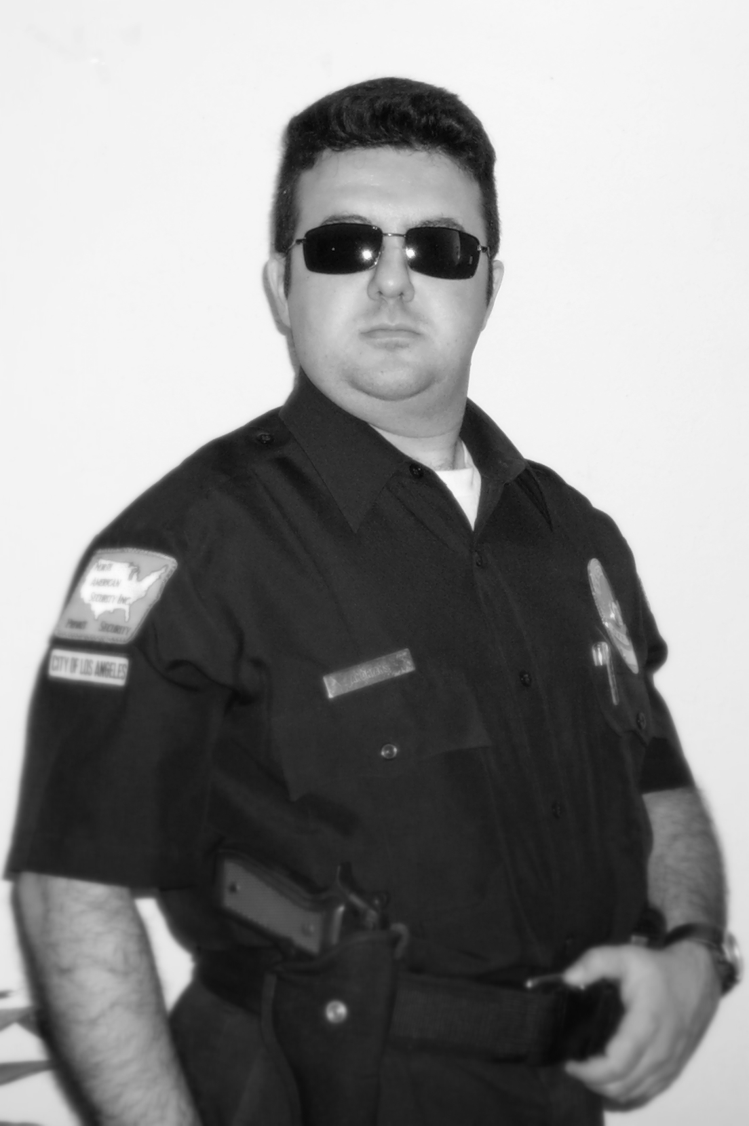
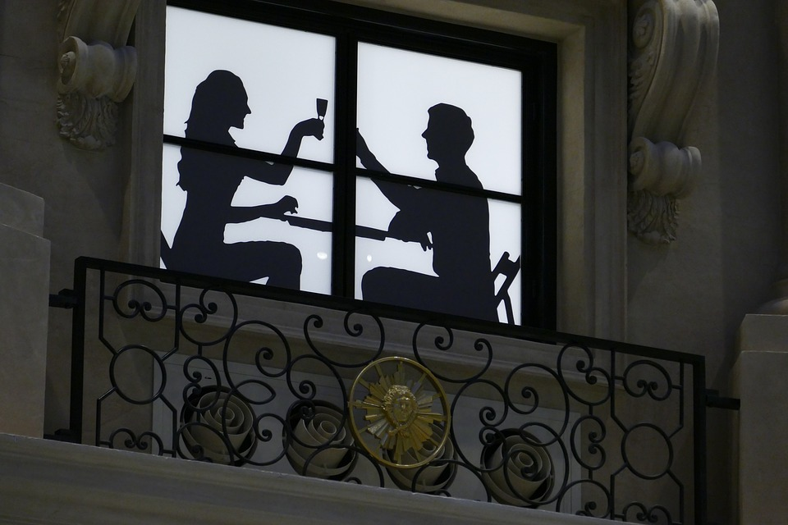
Security vs. privacy
Security
Privacy

Slide 29
Security vs. privacy: one definition
Security is about making sure the goals of a system can be achieved regardless of the presence of an adversary.
Privacy is about the rights of the user and their data, and protecting these from unwanted exposure.

Slide 30
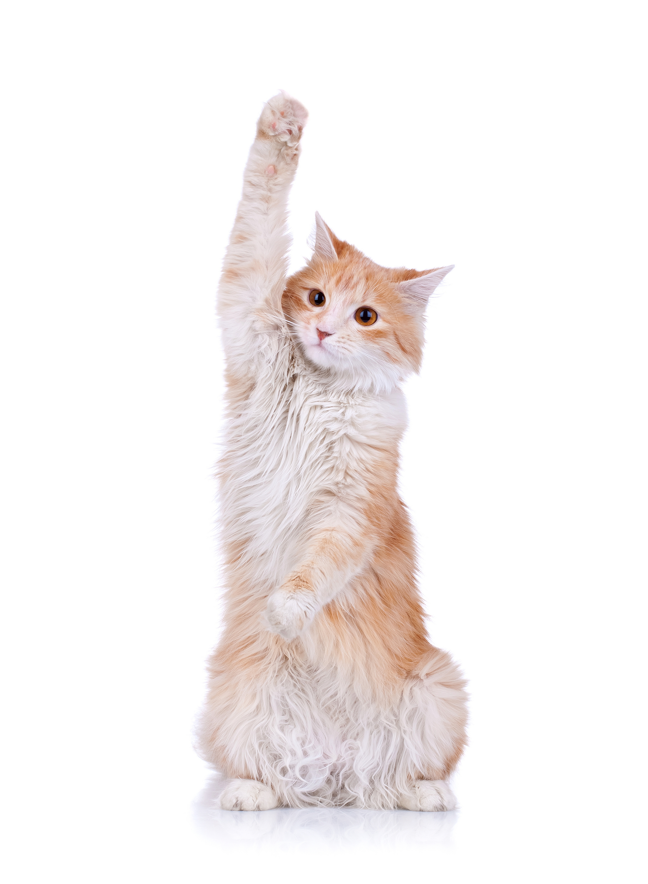
Questions and comments?

Slide 31
Basic Principles of Secure Software

Slide 32
Least privilege
Every program and every user should operate using the least set of privileges necessary to complete the job.
Example: military “need-to-know.”
Anti-example: Uber’s “God mode.”

Slide 33
Smallest trusted computing base
The trusted computing base (TCB) is a subset of the system essential to its security.
Kernel, network stack, hardware platform, …
Exact “boundary” depends on policy
Why do we want a small TCB?
Less code → less room for error → less risk
Need comprehensive tests, or detailed proofs
Rigorous validation is expensive, time-consuming

Slide 34
Complete mediation
Every access to every object must be checked for authority.
Is it enough to check at the application endpoints? (HotCRP email password reminder bug)
What should the policy be? (average salary example)

Slide 35
In this course…
We will see how to apply these principles to large, complex software systems.
We will see how to apply these principles with complex, state-dependent policies.
We will build our own systems that use this principles—and attack them!

Slide 36
Questions and comments?

Slide 37
Course Logistics

Slide 38
What we expect you to know
Official prerequisites: 15-122, 15-213.
How to teach yourself a programming language.
How to build software systems.
How to reason formally about computation.

Slide 39
Unit Overview
Unit | Theme
One | Single-user program correctness, the foundation of security and privacy.
Two | What happens when we have multiple users?
Three | How can we track sensitive values across complex programs?
Four | From security to privacy: statistical privacy.

Slide 40
Example topics we will cover
Formally stating and proving correctness properties with automata.
Techniques for verifiable security assurance in realistic systems.
Mechanisms for authentication and identity.
Language-based information flow.
Differential privacy.

Slide 41
Background: Build It Break It Fix It
Main questions
What goes into secure software development?
How do we teach people to write secure code?
Contest
Build software according to specifications
Break software written by other contestants
Fix bugs found in their software
Tasks are doable over 72 hours
Focus of our course assignments

Slide 42
Project Overview
Implement an “enhanced” version of the Build It Break It Fix It server
Progressively improve functionality alongside security
Some what you will build:
Basic data server with limited policy support
Reference monitor to support flexible, user-defined data policies
Proof-carrying authorization for fine-grained access policies
Information flow types to control data leakage
Differential privacy policies to protect individuals’ data

Slide 43
Grading
60% Assignments
30% Midterm and final exams
10% In-class quizzes and participation

Slide 44
What You Will Learn

Slide 45
Specifics
How to build a data server, and implement mechanisms to secure it in complementary ways.
How to formally reason about security and privacy properties of this server.
How to prove pencil-and-paper properties about your server.
How to attack your server and how to code in a way that defends against attacks.

Slide 46
Ways of thinking
How to formally specify software correctness.
How to formally reason about security goals and threat models.
How to build systems that are secure by construction.
How to think rigorously about attacks.

Slide 47
What now?
Make sure you sign in so we can add you to Piazza.
Bookmark our course website (http://cs.cmu.edu/~15316).
Do the OCaml finger exercises (from the course website).
Email us the necessary items from Assignments 0, and talk to us if you have questions about the course!

